Slide 1
PSCS385-Development of AI/ML based solution for detection of face-swap based deep fake videos
PIP2001 Capstone Project
Review-1
Batch Number: CIT-G25
Roll Number 20211CIT0133 20211CIT0134 | Student Name MANISH RANJAN M B
20211CIT0010 | JAMPULA VISHNU VARDHAN
20211CIT0030 | SHREEJIT S SHETTY
20211CIT0138 | Harsha Vardhan P
Under the Supervision of,
Dr. Mohana SD
Professor / Associate Professor / Assistant Professor
School of Computer Science and Engineering
Presidency University
Name of the Program: Btech
Name of the HoD: Dr. Ananda Raj
Name of the Program Project Coordinator: Dr.Sharmasth Vali
Name of the School Project Coordinators: Dr. Sampath A K / Dr. Abdul Khadar A / Mr. Md Ziaur Rahman

Slide 2
Abstract
The rise of deep fake technology, particularly face-swap videos, has raised significant concerns regarding the spread of misinformation and the invasion of privacy. These highly realistic forgeries pose a challenge to current detection methods, which often fail to accurately identify them. This project aims to address this issue by developing a straightforward and effective AI/ML-based solution to detect face-swap deep fake videos. By analyzing visual and auditory inconsistencies, such as mismatches in facial movements, lighting, and audio-visual synchronization, the proposed system seeks to enhance the accuracy and reliability of deep fake detection. The ultimate goal is to provide a robust tool that can be deployed to mitigate the harmful effects of deep fakes, thereby safeguarding digital integrity and privacy.

Slide 3
Literature Survey :
Here’s a literature survey based on the papers that we have researched:
1. This paper likely explores advanced techniques for detecting deepfakes, focusing on the challenges posed by increasingly realistic synthetic media.
2. This paper probably investigates the role of deep learning architectures, such as convolutional neural networks (CNNs), in detecting deepfakes.
3. This research likely focuses on the ethical and societal implications of deepfake technology, alongside technical detection methods. It may propose a multi-modal approach that combines visual, auditory, and behavioral cues to improve detection rates.
4. This paper might present a comparative analysis of existing deepfake detection techniques, highlighting their strengths and weaknesses. It could introduce a hybrid model that integrates traditional image processing methods with deep learning to enhance detection performance. The study may also emphasize the need for robust datasets to train and test detection systems.
5. This research likely explores the use of generative adversarial networks (GANs) in creating and detecting deepfakes. It may propose a GAN-based detection system that identifies inconsistencies in synthetic media by analyzing pixel-level details. The paper could also discuss the adversarial nature of deepfake creation and detection.

Slide 4
6. This paper probably focuses on the role of audio-visual synchronization in deepfake detection. It may propose a method to analyze mismatches between lip movements and speech patterns to identify fake videos. The study could also highlight the importance of multi-modal approaches in improving detection accuracy.
7. This research likely addresses the challenges of detecting deepfakes in low-quality or compressed videos. It may propose a lightweight detection model that can operate efficiently on resource-constrained devices. The paper could also discuss the trade-offs between detection accuracy and computational complexity.
8. This paper might explore the use of explainable AI (XAI) techniques in deepfake detection. It may propose a model that not only detects deepfakes but also provides interpretable insights into the decision-making process. The study could emphasize the importance of transparency in building trust in detection systems.
9. This research likely investigates the role of temporal analysis in detecting deepfakes. It may propose a method that analyzes frame-by-frame inconsistencies in videos to identify synthetic content. The paper could also discuss the challenges of detecting deepfakes in real-time streaming applications.
10. This paper probably focuses on the use of transfer learning in deepfake detection. It may propose a pre-trained model that can be fine-tuned for specific datasets or scenarios. The study could also highlight the benefits of transfer learning in reducing the need for large annotated datasets.

Slide 5
Objectives :
Key Objectives for the Development of an AI/ML-Based Solution for Detecting Face-Swap Deep fake Videos
1. Develop a Deepfake Detection System
Objective: To build a system capable of detecting deepfake videos by analyzing visual artifacts and inconsistencies in video frames.
2. Create a Custom Dataset
Objective: To collect and organize a dataset of real and deepfake videos from publicly available sources (e.g., YouTube) for training and testing the model.
3. Implement Frame Extraction
Objective: To extract and preprocess frames from videos, ensuring they are resized and normalized for consistent input to the model.
4. Design a Convolutional Neural Network (CNN)
Objective: To design and implement a lightweight CNN architecture capable of learning spatial features from video frames and classifying them as real or fake.

Slide 6
5. Train the Model
Objective: To train the CNN model on the custom dataset using techniques like binary crossentropy loss and the Adam optimizer to achieve high accuracy.
6. Test the Model on New Videos
Objective: To evaluate the trained model on unseen videos by processing frames individually and aggregating predictions to classify the entire video.
7. Ensure Scalability and Flexibility
Objective: To create a system that can handle various video formats and resolutions, making it adaptable to different use cases.
8. Provide a User-Friendly Interface
Objective: To develop a simple and intuitive workflow that allows users to upload videos, run the detection system, and receive results (real or fake).

Slide 7
Existing Methods & their Drawbacks :
1.Deep Learning Models:
Method: Many studies utilize convolutional neural networks (CNNs) and recurrent neural networks (RNNs) for detecting anomalies in faces and videos.
Drawback: These methods require large amounts of labeled data for training, and the models can be computationally expensive, limiting real-time applicability.
2.Facial Feature Analysis:
Method: Some approaches focus on analyzing facial features such as eye blinking, lip movements, and facial expressions to detect inconsistencies.
Drawback: This method may not be effective when the deepfake uses high-quality manipulation or when the face is partially obscured.
3.Temporal and Spatio-Temporal Analysis:
Method: Methods that examine the temporal dynamics or motion patterns across frames, especially in video deepfakes, to identify abnormalities in how the face moves or the background changes.
Drawback: These methods often fail in detecting deepfakes that employ advanced techniques such as frame interpolation or fine-grained motion manipulation.

Slide 8
4.Ensemble Learning Approaches:
Method: Combining multiple machine learning models or features from different domains (like textures, edges, and motion) to improve detection accuracy.
Drawback: The increased complexity of ensemble models can lead to slower detection times and require more computational resources.
5.Generative Models (e.g., GANs):
Method: Some methods use Generative Adversarial Networks (GANs) for both generating deepfakes and detecting them by distinguishing between real and fake images.
Drawback: These models may struggle with detecting deepfakes that are generated with the same GAN architecture or with newer adversarial techniques that simulate realness more effectively.

Slide 9
Proposed Methodologies :
1. Setup Environment:
Install Python, required libraries (TensorFlow, OpenCV, etc.), and FFmpeg.
2. Dataset Preparation:
Download real and deepfake videos from YouTube using youtube-dl.
Extract frames from videos and organize them into folders (real and fake).
3. Model Training:
Build a Convolutional Neural Network (CNN) using TensorFlow/Keras.
Train the model on extracted frames to classify them as real or fake.

Slide 10
Proposed Methodologies :
4.Testing:
Use the trained model to process a new video frame by frame.
Average predictions to classify the video as Real or Fake.
5.Results:
The system outputs whether the video is real or fake based on the model's predictions.
6.Flexibility:
Works with any video format.
Can be improved by adding more data or using advanced techniques.

Slide 11
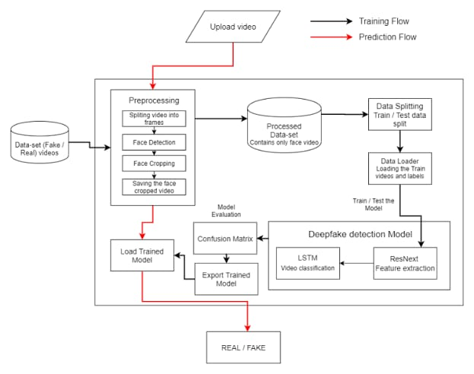
Architecture Diagram :

Slide 12
Hardware and Software Details :
Hardware requirements
GPU: NVIDIA RTX 30XX series or higher (e.g., RTX 3090, A100)
CPU: Intel i7/i9 or AMD Ryzen 7/9 series.
RAM: 32GB or more.
Storage: SSD (1TB+), optional external storage (4TB+)
Networking: High-speed internet (for cloud computing)
Software Requirements
Operating System: Linux (Ubuntu 20.04+) or Windows 10/11
Deep Learning Frameworks: Tensor Flow or PyTorch
Libraries: OpenCV (video processing),librosa (audio processing),Hugging Face Transformers (for temporal analysis),Scikit-learn (evaluation, metrics),NumPy & Pandas (data handling)
Self-Supervised Learning Libraries: SimCLR or BYOL
Data Augmentation/Pre processing: Albumentations, Speech-to-Text API
GANs: CycleGAN, StyleGAN, custom GAN implementations
Deployment: Flask/ FastAPI, Dockers
Visualization: Tensor Board, Visdom, Matplotlib, Seaborn

Slide 13
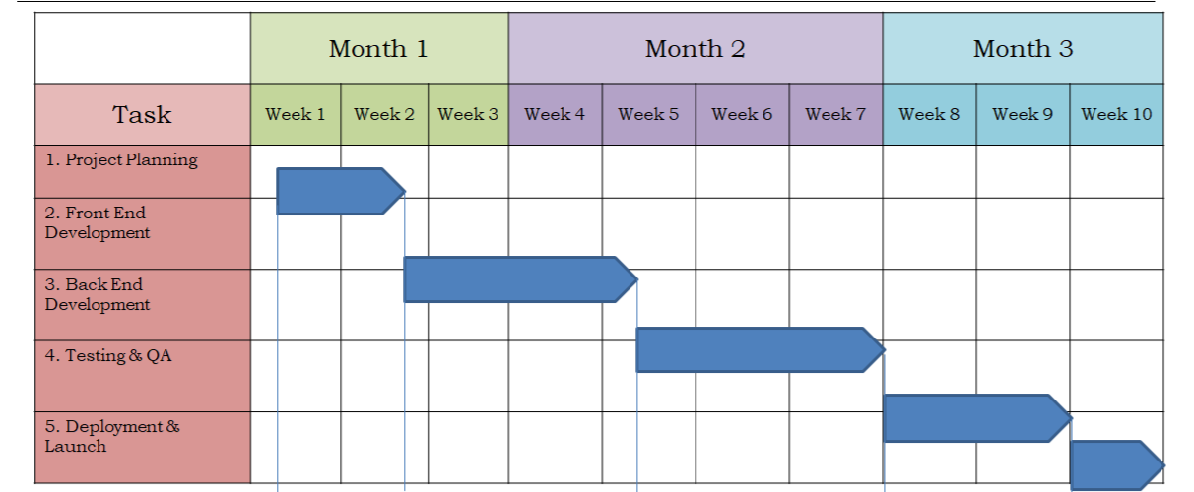
Timeline of the Project (Gantt Chart)

Slide 14
References (IEEE Paper format)
Deepak Dagar; Dinesh Kumar Vishwakarma ,A Diverse Manipulation Deepfake Video Dataset, 2020
Anis Trabelsi; Marc Michel Pic; Jean-Luc Dugelay,Improving Deepfake Detection by Mixing Top Solutions of the DFDC ,2019
Jixin Zhang; Ke Cheng; Giuliano Sovernigo; Xiaodong Lin, A Heterogeneous Feature Ensemble Learning based Deepfake Detection Method,2022
Shan Jia; Xin Li; Siwei Lyu, Model Attribution of Face-Swap Deepfake Videos,2021
Siddharth Yadav; Sahithi Bommareddy; Dinesh Kumar Vishwakarma, Robust and Generalized DeepFake Detection,2020
Qasim Jaleel; Israa Hadi Ali, Facial Behavior Analysis-Based Deepfake Video Detection using GAN Discriminator,2022
Sio Jurnalis Pipin; Ronsen Purba; Muhammad Fermi Pasha, Deepfake Video Detection Using Spatiotemporal Convolutional Network and Photo Response Non Uniformity,2021
Reva Chinchalkar; Rachita Sinha; Manish Kumar; Neeraj Chauhan; Shubhangi Deokar; Sudhanshu Gonge, Detecting Deepfakes using CNN and LSTM,2022
Lalitha S; Kavitha Sooda, DeepFake Detection Through Key Video Frame Extraction using GAN,2021

Slide 15


